Slide 1
Hamilton School
CQ - November 2018

Slide 9
190 days vs transformation
“I personally measure success in terms of the contributions an individual makes to his or her fellow human beings”
Margaret Mead

Slide 10
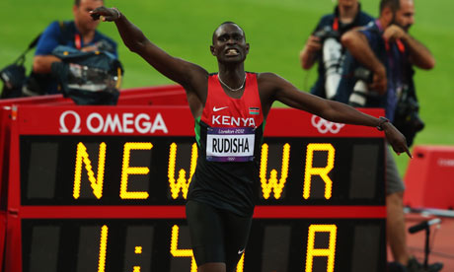
Personal Bests

Slide 11
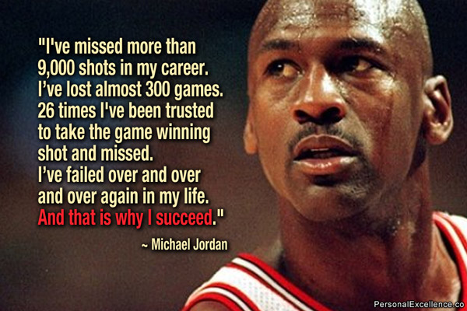
Taking calculated risks and innovating – things will go wrong!

Slide 12
Lester Freamon – “We’re building something here detective, we’re building it from scratch, all the pieces matter”

Slide 13
A guiding principle
Balancing the need to meet today’s demands with the need to invest in the capabilities that will produce tomorrow’s success.

Slide 14
Extended Family – page on website
How do you make talented people and groups want to work with you when everyone has limited resources…?

